Slide 1
Lecture
ASMX Web Services

Slide 2
Introduction to Web Services
A Web Service is a component that exists on a web server which can be called from a client application.
Web services are contained in a file with the “.asmx” file extension.
A web service is a class that can be accessed through the Internet or network connection.
It has a special interface that allows it to be instantiated and have its methods called.
Web services can be access from a variety of client applications.
Web application (aspx page)
Windows form application (C# form)
HTML page
Mobile application

Slide 3
Web Service Advantages
Web services enable processing of an application to be distributed.
A part of a web application can be processed on one server, while other parts are processed on another server.
Multiple applications can utilize the web service.
Components created for one project/application can be used in many other projects/applications.
Applications created by different companies can interact with one another.
Look at how many sites use Google Maps!

Slide 4
Web Service Advantages
Applications that use a web service (consumer) don’t need to know anything about the platform, programming language, or logic used to implement the web service; they only need to know how to send and receive messages.

Slide 5
How Web Services Work
The ability to use a web service from different applications and servers comes from XML.
The power of XML is due to the fact it can be used by different operating systems, programming languages, or data stores.
XML is used to communicate with a web service.
XML is ideal for data representation because it enables developers to structure the XML to fit their needs.

Slide 6
Web Services & Clients
Diagram
Client Browser Making Request
Web Server 1 ASP.NET Web Server Processing Request
Web Server 2 ASP.NET Web Server Containing Web Service
Web Service Client Server-Code Making Request to Web Service
Web Service 1
MethodA MethodB MethodC
Web Service 2
MethodA MethodB MethodC

Slide 7
How Web Services Work
SOAP (Standard Object Access Protocol) is a protocol that provides a format (syntax) for using XML to send a request to a web service and receive a response.
It allows for passing complex data structures between a web service and the client application.
It is used to communicate facilitate communication between a client (the consumer of the web service) and web service.
WSDL (Web Service Description Language) is a format for describing a web service for the purpose of invoking its methods, and returning results from them.
WSDL is to SOAP as HTML is to HTTP
HTML is a language used to describe web pages, which are transferred using HTTP.
WSDL is a language used to describe a web service class, and data is transferred using SOAP.

Slide 8

SOAP
SOAP is a protocol that specifies the format of messages used to communicate with a web service.
Works in conjunction with HTTP.
A SOAP message contains two parts:
Envelope
Message Header (optional)
Message Body
Web Service Client – Web Service Server Interaction:
First, the web service client sends a SOAP request message to invoke a web service method.
The message body contains the name of the method to invoke and any input arguments for the method to use.
After the web service method executes, the web service server sends a SOAP response, which includes the return value of the method.
The message body contains the return value of the method.

Slide 9
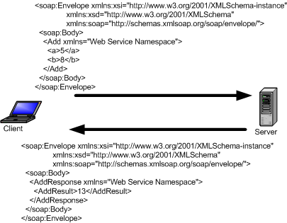
SOAP Messaging Example

Slide 10
Web Service & WSDL
A web application uses the WSDL file for a specific web service class to generate a web service proxy class for using that web service.
The WSDL file is automatically generated when a web reference is created for a project.
A web service proxy class is used to create an object that acts as an interface between the web service client application (running on machine A) and the web service (running on machine B).
The proxy hides all the “black box” workings.
The proxy is responsible for creating the SOAP request messages, and receiving of SOAP response messages.

Slide 11
Web Service & WSDL
The web service proxy class is used to perform the following functions at run-time:
It will start the web service and the session on the server hosting the web service, if it’s not already running.
It will enable the client application to “import” the “class” of the web service and instantiate it as an object.
It simply builds an object from the description of the web service class contained in the WSDL file.
It enables the client to use this object to call web service methods, pass arguments, and return values as though the web service was running on the same machine.
In actuality, the proxy is communicating with the web service on another machine over the network.

Slide 12
Creating & Consuming a Web Service
Steps to create and consume a web service:
Create the web service by adding a web service item (ASMX file) to web application project. Write the necessary methods in the web service’s class.
Publish the web service.
Add a Web Reference to the projects that will use the web service.
Create a web service proxy and use it in the ASPX page that will need to access the web service.

Slide 13
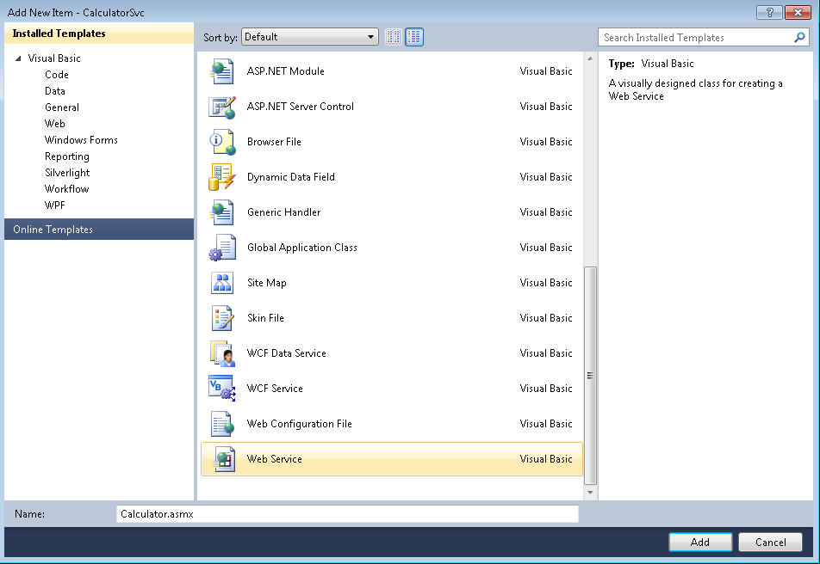
Creating a Web Service
Create the web service by adding a new item to a web application project.

Slide 14
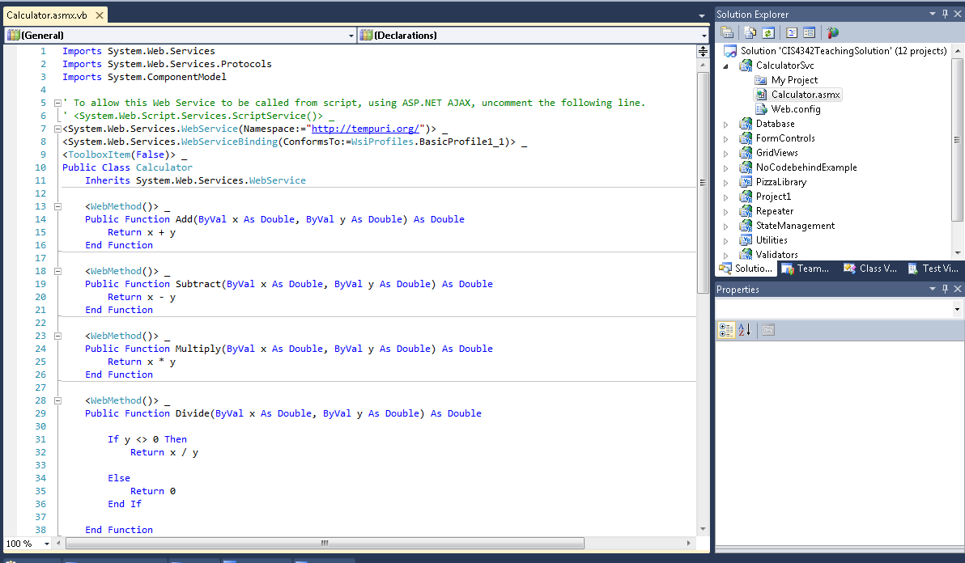
Creating a Web Service
A web service contains a class very much like the CodeBehind class of an ASPX page.

Slide 15
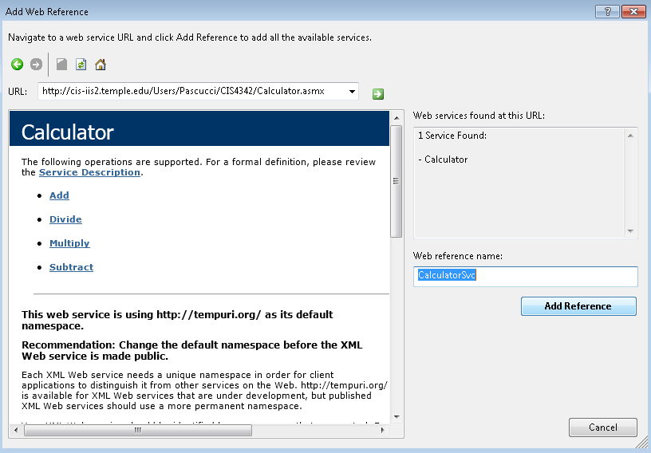
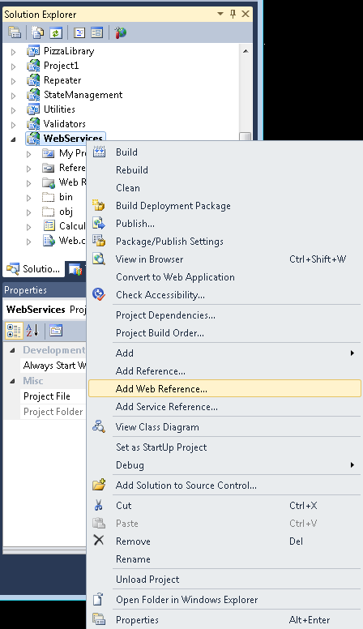
Adding a Web Reference
Add a Web Reference (to the published web service) to the web application project that will use the web service.

Slide 16
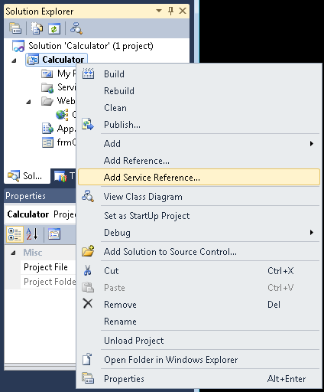
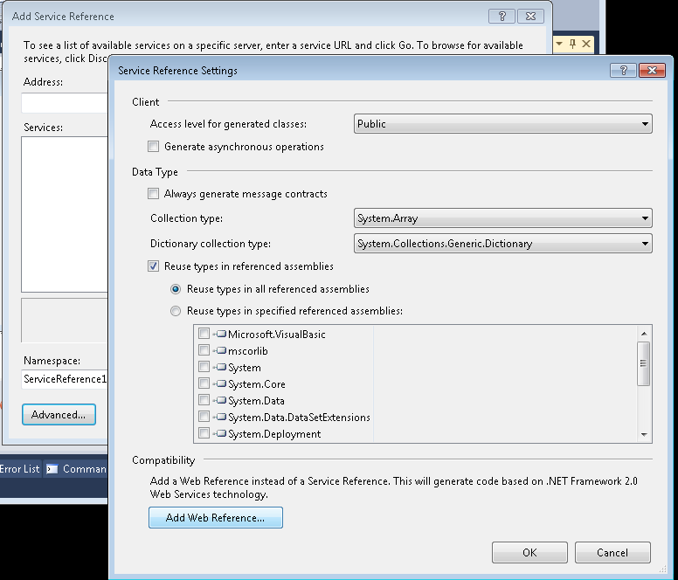
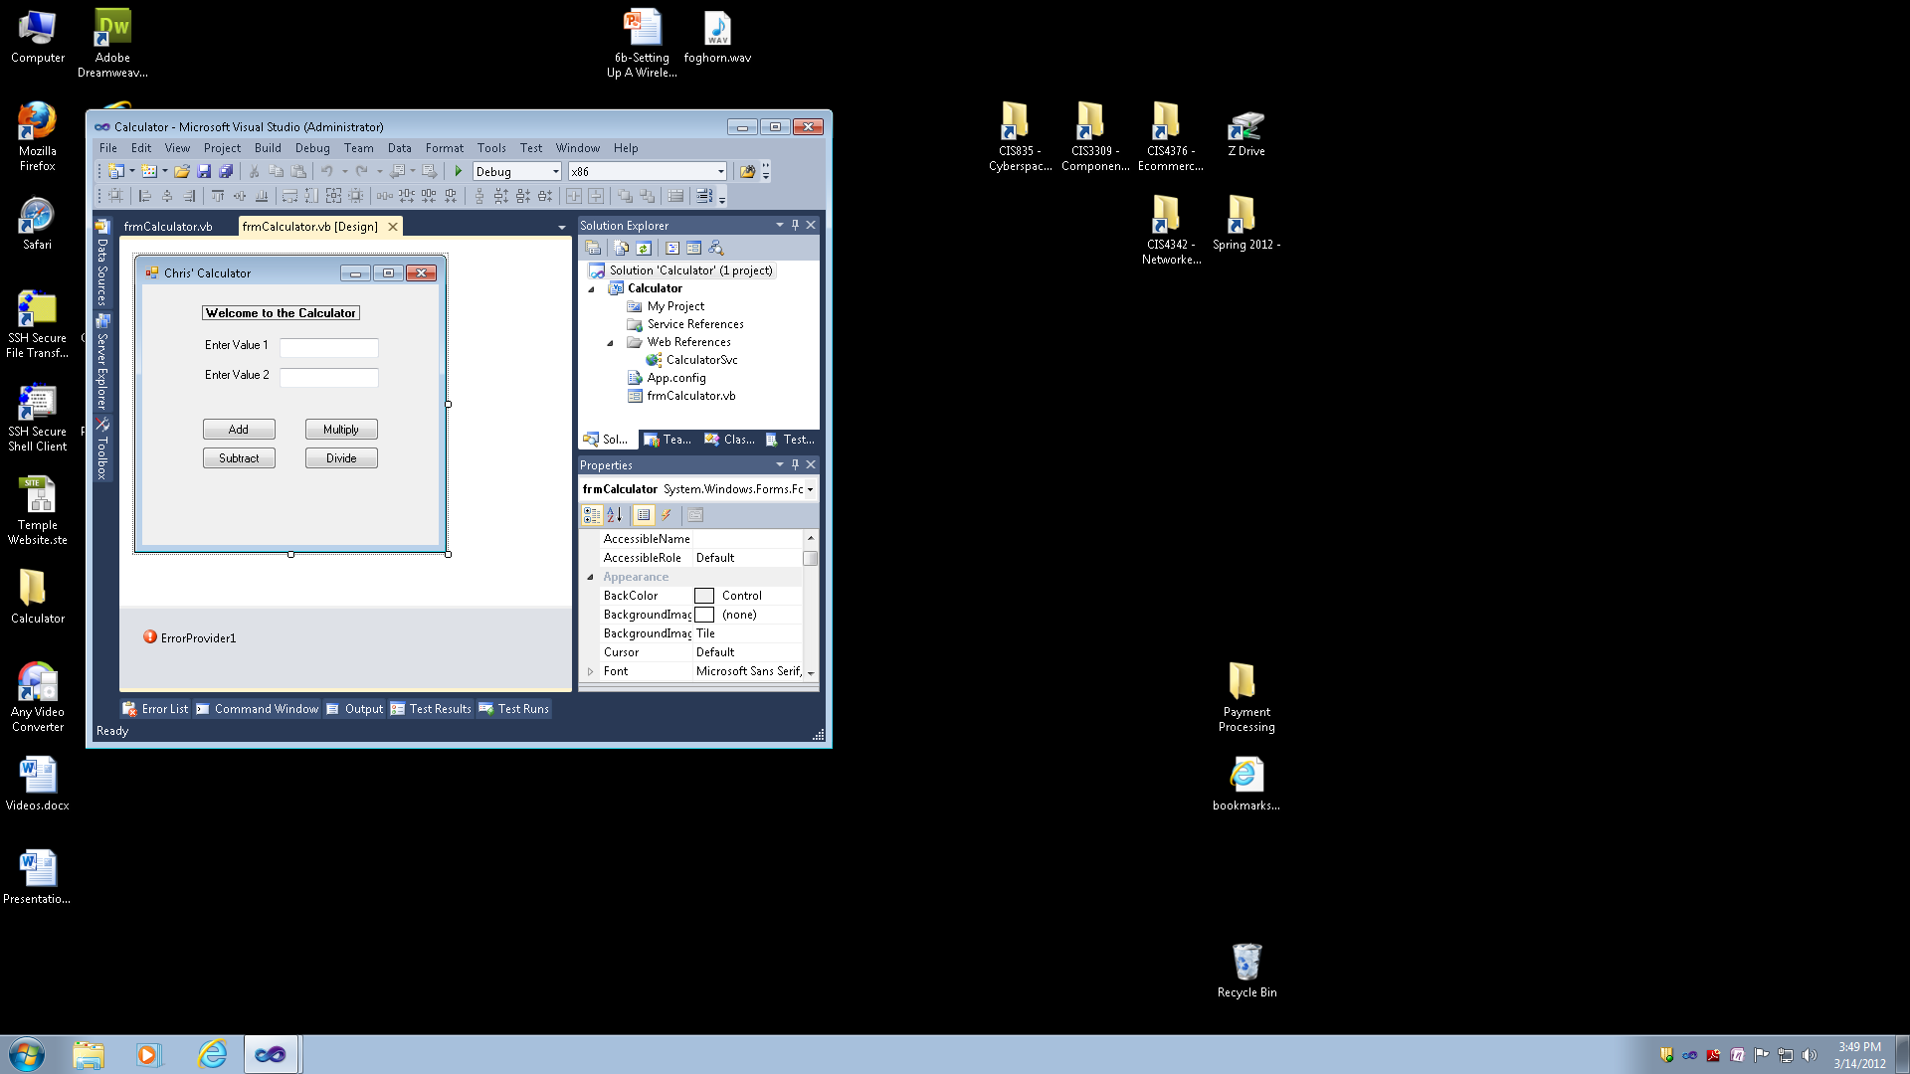
Adding a Web Reference
Adding a Web Reference to a Windows Form Application.

Slide 17
Discovery Process
The Discovery Process is the process of locating, or discovering, a web service.
It is through the discovery process that a web service client learns that a web service exists and the location of the web service's description document (WSDL file).

Slide 18
Create & Use the Web Service Proxy
Create an instance of the web service proxy class that will communicate with the web service, and use the web service proxy object to invoke web service methods.
This instantiates an object on the client that mimics the Web Service, and it’s used to send requests to the Web Service and receive a response from it via SOAP/HTTP.
Example of creating a web proxy
CalculatorSvc.Calculator pxy = new CalculatorSvc.Calculator();
The name given to the web reference.
The name of the web service class inside the ASMX file.

Slide 19
Using the Web Proxy
Example of using a web proxy
CalculatorSvc.Calculator pxy = new CalculatorSvc.Calculator();
double result = pxy.Add(2, 5);
The web service proxy class available after the discovery process (adding a web reference)
The arguments passed to the proxy that will be sent to the Web Service Add Method
The web service proxy object that communicates with the Web Service

Slide 20
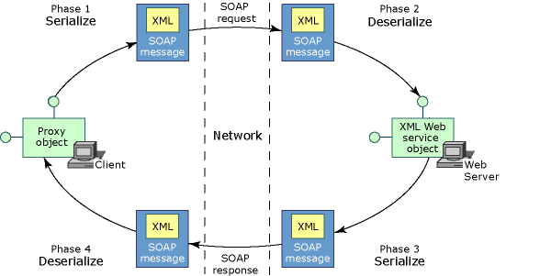
SOAP Messaging Diagram

Slide 21
DataTypes & Web Services
Web service methods can accept different data types as input to a method, and methods can return a variety of different data types.
However, there are some limitations regarding this.
“Simple” Data Types (String, Integer, Double, DataSet, Array) can be passed to methods and returned by them with no problems.

Slide 22
Web Methods & Arguments
Arguments Passed By Value to a Web Service:
By default, an argument is passed by value to a Web Service Web Method. This means only a copy of the value in the actual argument variable gets passed into the method.
This type of argument is called an input argument.
The method cannot modify the actual argument variable’s contents because the value inside the actual argument variable is passed, not the memory address of the actual argument variable.
In other words, the value of the actual argument variable passed into the method can be changed within the method, but the changed value will not affect the actual argument variable passed into the method when the method was called.
The web method can only affect its local version.
This is true for all reference-types (class-based types), too.
In object-oriented programming, passing a reference-type would allow the method full control of the object the argument references; reference-type variables contain a reference to an object, so the object’s data can be changed by the method.
This isn’t how a Web Method works since the web service can be on a different computer that doesn’t have access to a web service client’s object in memory.

Slide 23
Web Methods & Arguments
Arguments Passed By Reference to a Web Service:
If you designate an argument to be passed by reference, both the Web Service Web Method and the Web Service Client will have two separate copies of an object, but any changes made by the Web Service Method will affect the Web Service Client’s object, too.
This type of parameter can be used for both input and output.
The Web Service Proxy object is responsible for modifying the Web Service Client’s object that was passed by reference.
The Web Service sends a copy of any object that was passed by reference in the response, so the Web Service Proxy object can make the necessary changes.
Value-type variables passed by reference work the same way except they don’t contain objects.
The Web Service Proxy object is responsible for updating the contents of a value-type variable based on the changes made by the Web Method.
Note: this is different from how object-oriented programming languages work when a method’s arguments are passed by reference.

Slide 24
DataTypes & Web Services
Complex Data Types (User-Defined Types) can be passed to methods and returned with no problems.
However, you must use the web service’s version of the class (UDT).
Example: CalculatorSvc.Calculator pxy = new CalculatorSvc.Calculator();
CalculatorSvc.Fraction fraction1 = new CalculatorSvc.Fraction();
The main difference between the “simple-type” and “complex-type” is that the simple-type variables are declared on both sides locally, while a complex-type is declared on both sides using the web service’s description of the class.
This is made possible by WSDL.
You can find the classes that are generated by WSDL in the Reference.cs (or Reference.vb) file listed under the Web References section of a Visual Studio project.
The Web Service’s version of the Fraction class, which is accessible to the Web Service class.

Slide 25
DataTypes & Web Services
The Discovery Process will automatically include in the WSDL a description for most custom user-defined classes used in the Web Service.
It will only include user-defined classes that are used as either a parameter to a Web Method or return type of a Web Method.
If the Web Service client needs to use a class from the Web Service that isn’t provided in the WSDL, you can force the Web Service to include them.
You need to use the XmlInclude attribute for a Web Method.
This requires importing the System.Xml and System.Xml.Serialization namespaces.
Example: [XmlInclude(typeof(Movie))]

Slide 26
DataTypes & Web Services
Exposing a user-defined class of a Web Service:
[WebMethod] [XmlInclude(typeof(Car)] [XmlInclude(typeof(Truck)] public Vehicle ReturnVehicle() { … }

Slide 27
DataTypes & Web Services
ArrayLists are a special case.
Even though you can declare an object to be of type ArrayList, it can contain objects of any type.
Therefore, the Client does not have any definition of the contained objects of an Arraylist that is declared and populated with objects on the Web Service side.
An ArrayList can be passed from a Web Service method to the client, but you must use a new syntax.
Syntax: ArrayList myArray = new ArrayList(WSPxy.theMethod()); // where the web service method returns an Arraylist

Slide 28
DataTypes & Web Services
An ArrayList cannot be passed easily from a client to a Web Service method.
The easiest way to pass an ArrayList is to convert it to an array of objects (object[]).
Example: object[] myArray = myArrayList.ToArray(); // pass myArray to a Web Method that accepts an ArrayList
Another option is to serialize the ArrayList to a ByteArray (byte[]) and then sent to the web service. Once received by the web service method, it needs to be deserialized back into an ArrayList.

Slide 29
Maintaining State in a Web Service
Typically, you may need to use the Session object in the web service in order to persist objects across multiple calls from the Client.
However, the web service (asmx.cs), unlike the web application (aspx.cs), has Session disabled by default, so it must be explicitly enabled.
A web service can use a Session object to persist its own internal objects and data as well as to transmit such a persisted object to the client.

Slide 30
Maintaining State in a Web Service
A web proxy object creates a new session id for each new request, so the web service always thinks it is communicating with a new session.
The reason is that there is no place in the web proxy object to store cookies (the session id cookie) that are returned by the web service.
Remember the proxy is communicating with the web service from server-side code, not the browser.
When the client sends a request, the server sends back a response with an HTTP Set-Cookie header that has a name/value pair in it. For all subsequent requests to the same server, the client sends the name/value pair in an HTTP Cookie header.

Slide 31
Maintaining State in a Web Service
You need to create a CookieContainer for the web proxy object to store the session id cookie; then, the web service can retrieve the cookie that stores the session id, and associate the session with its data.

Slide 32
Maintaining State in a Web Service
Steps in using session state to maintain data on the web service and allow the client (web proxy object) to store the session id cookie:
First, enable session for each web service method by modifying the WebMethod attribute of each method. [WebMethod(EnableSession = true)]
Now, you can use the Session object as you normally would in the web service method’s code.
A session object will now be created in the Web Service with a unique session id when its proxy class on the client-side (the consumer) is instantiated.
Next, add a CookieContainer to the proxy class object in order to convey this web service’s server session id back and forth with subsequent calls to the web service methods. using System.Net; pxy.CookieContainer = new CookieContainer();

Slide 33
Maintaining State in a Web Service
Lastly, store the web proxy object in the client’s (the consumer) session object. Session[“pxy”] = pxy;
You need to do this because the codebehind object and all objects contained in it are destroyed when the server-side code that is using the web service returns the HTML to the browser.

Slide 34
Web Service to Client Interaction
The web server receives a request from the browser. The server-side code uses a web service to distribute processing of the request.
The web service client creates a new instance of an Web service proxy class. This object resides on the same computer as the web service client (code using the web service).
The web service client (consumer) invokes a method on the proxy class.
The infrastructure on the web service client computer serializes the arguments of the web service method into a SOAP message and sends it over the network to the web service.
The infrastructure on the web server that contains the web service being consumed receives the SOAP message and deserializes the XML.
It creates an instance of the class implementing the web service and invokes the web service method, passing in the deserialized XML as arguments.
The web service method executes its code, sets the return value and any output (by reference) parameters.

Slide 35
Web Service to Client Interaction
The infrastructure on the web server serializes the return value and out parameters into a SOAP message and sends it over the network back to the client (consumer of the web service).
The web service infrastructure, on the client computer, receives the SOAP message, deserializes the XML into the return value and any out parameters, and passes them to the instance of the proxy class.
The client receives the return value and any output parameters, which gets used in processing the browser’s request (original client for the web request that set all of this in motion).
The ASP.NET web server sends the HTML response to the browser that made the request.
*** Modified from an MSDN source.
See the diagram on Soap Message

Slide 36
Web Service Development Process
You should develop the Web Service and Web Service Client locally before publishing and deploying them.
You can use the debugger for a Web Service that is locally developed and referenced. You cannot debug published Web Services.
Create the Web Service as .asmx and .asmx.cs files in a separate Web Application Project.
Create the Web Service Client (ASPX and .aspx.cs files) in a separate Web Application Project.
Create a Web Reference in the Web Service Client project.
Use the Discovery Process, but make sure you choose the option “Web Services in this Solution”.
Run & Test the Web Service Client.
Maintain both the Web Service Client and Web Service

Slide 37
Web Service Deployment Process
After you complete the Web Service and fully test it, you should deploy it.
Publish the Web Service project.
Change the Web Service Client Web Application project by replacing the old Web Reference that referred to the local version of the Web Service with a new Web Reference that uses the published version.
Use the Discovery Process to create a Web Reference, but this time use the URL to the published Web Service instead of the Web Service in the solution.
Option 1: delete the old Web Reference and create a new one with the same name, you don’t need to modify the code that uses it.
Option 2: you can create a separate Web Reference with a new name, but you must modify all code to use the new Web Reference.
Compile the Web Application (Web Service Client), and Run & Test it.
Publish the Web Service Client Web Application.

Slide 38
Maintaining the Web Service
It may be necessary to modify the Web Service, the Web Service Client, or both of them.
During the development process recompilations (rebuilds).
Deployment of the Web Service and the Web Service Client after the development process.
There are important steps you need to follow every time you modify the Web Service.
Otherwise, the Web Service Client will not work or it won’t have access to new features and changes.

Slide 39
Maintaining the Web Service
Important Maintenance Steps:
Recompile the Web Service and publish it.
Before you publish the updated Web Service, delete the ASMX on the web server (using the mapped drive),
Note: skip the publishing step when you use the local Web Service from the solution.
Update the Web Reference for each web application project that uses the Web Service.
You don’t need to perform the discover process again by making a new Web Reference, you only need to update it.
Right-click the Web Reference located in the Web References folder inside the Project that uses it, and click Update Web Reference.
Recompile the Web Service Client and modify the code to use the Web Service as needed.
The web proxy object name doesn’t change, but the functions that are used in your code might be different.
This means you will need to fix any of the errors in the code that may arise due to the changes in the Web Service class.
Implement any of the new features or changes as needed.
Recompile the Web Service Client project, and deploy it.

Slide 40
Additional Information & Sources
Passing Collections to a Web Service
http://cis-iis1.temple.edu/cis342/Lectures/Unit2/WebServices/CollectionsArticle/PassingCollections.htm
MSDN Article explaining Session State Management http://msdn.microsoft.com/en-us/library/aa480509.aspx
Anatomy of a Web Service http://msdn.microsoft.com/en-us/library/x05s00wz%28v=vs.100%29.aspx

